Slide 1
Getting Started with Spitfire: Basic Navigation
Spitfire Project Management System

Slide 2
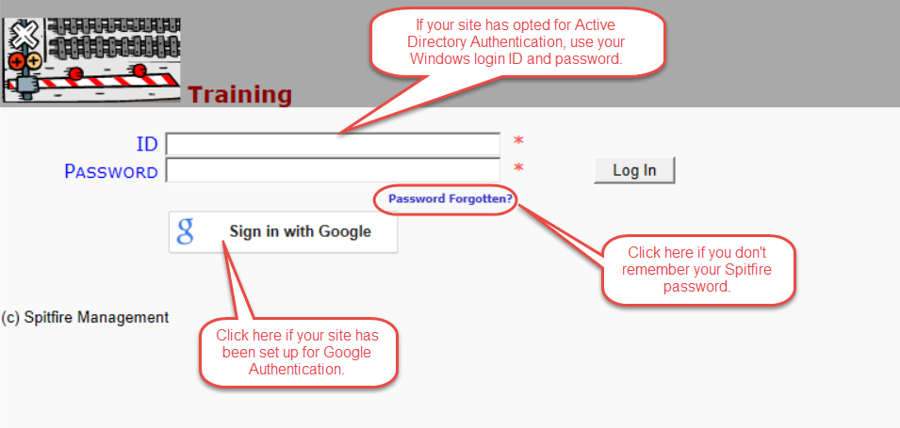
Log in to sfPMS

Slide 3
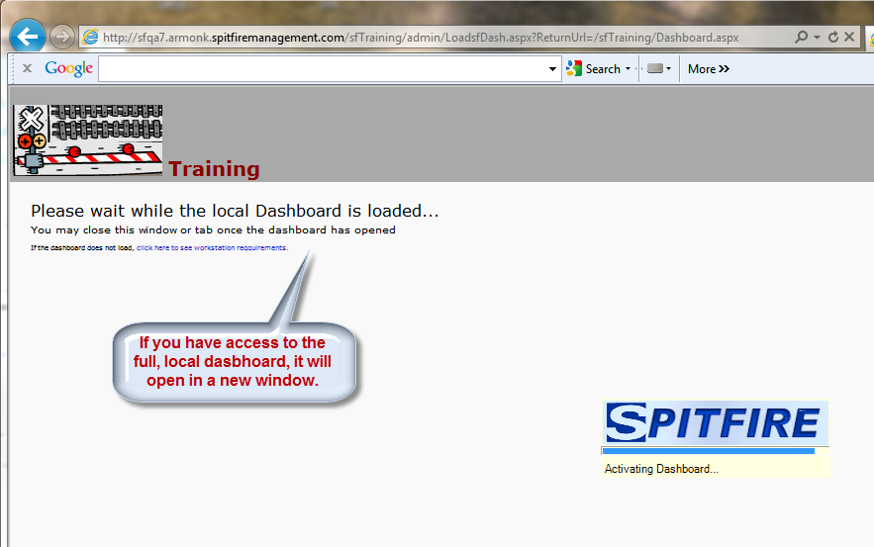
Local Dashboard

Slide 4
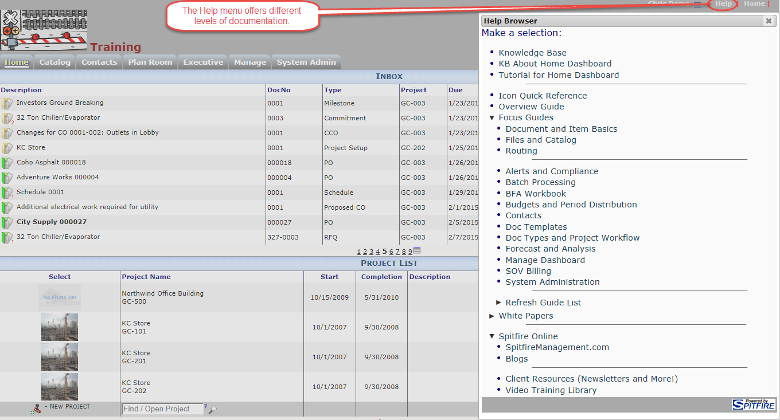
Focus Guides, TWPs and KBAs

Slide 5
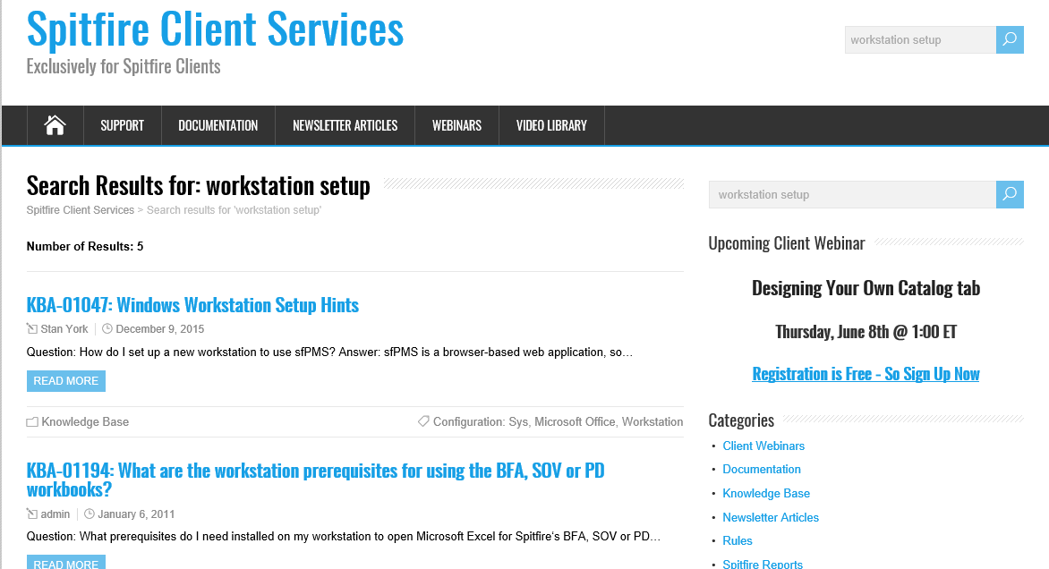
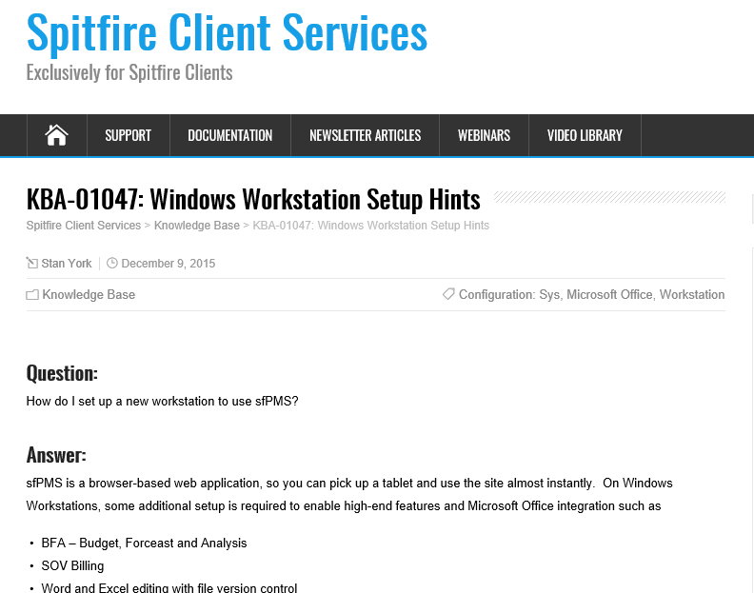
Spitfire Client Services site
http://support.spitfirepm.com

Slide 6
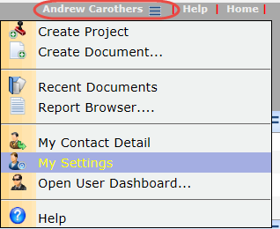
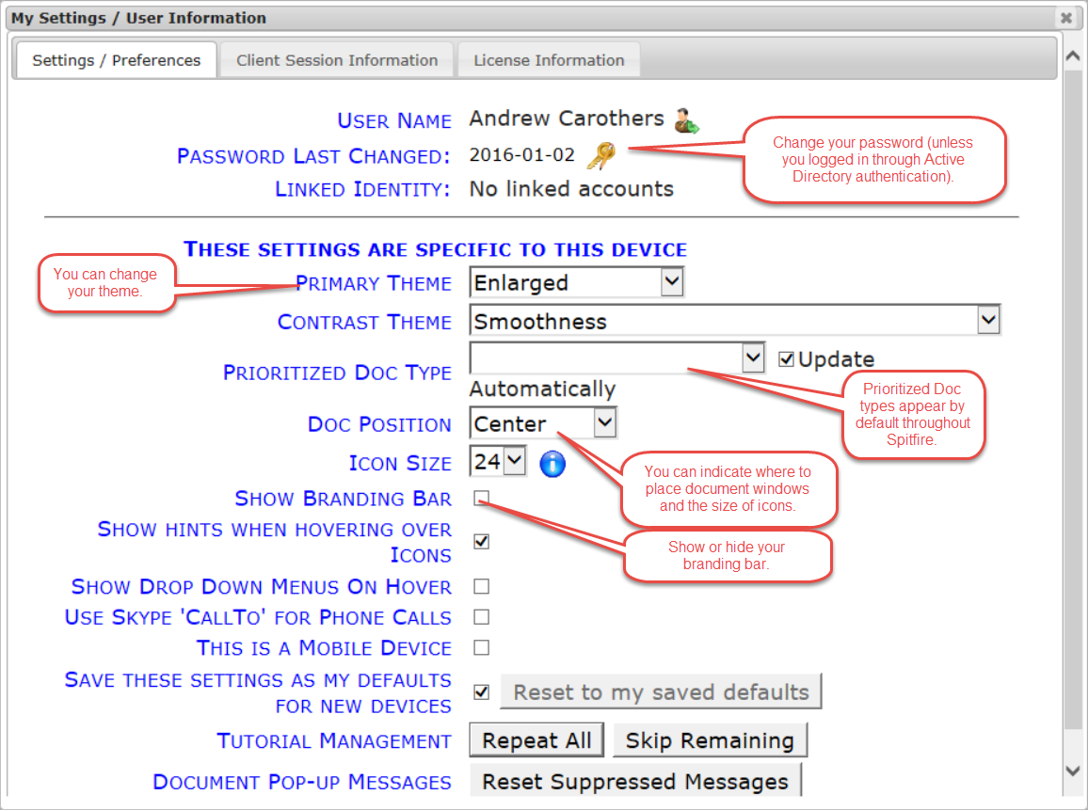
Your Settings
Click on you name in the upper right corner of the screen

Slide 7
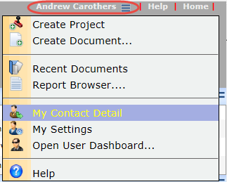
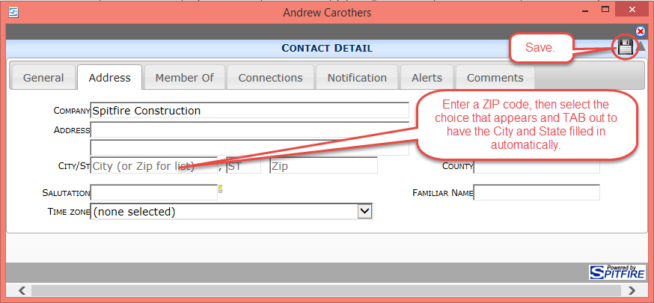
Your Contact Detail Window
Click on you name in the upper right corner of the screen

Slide 8
Concept: Roles
Roles determine your permission and access levels through capabilities
Project Manager
Can change the document status
Can set document status to Approved
Can check out files
Can set up Alerts
Can edit documents
Can post expenses and revenue
Can see all contacts
Can attach files
Can view reports
and more…
Project Assistant
Can change the document’s status
Can access the project dashboard
Can view site address
Can view documents on project
Can view team project members

Slide 9
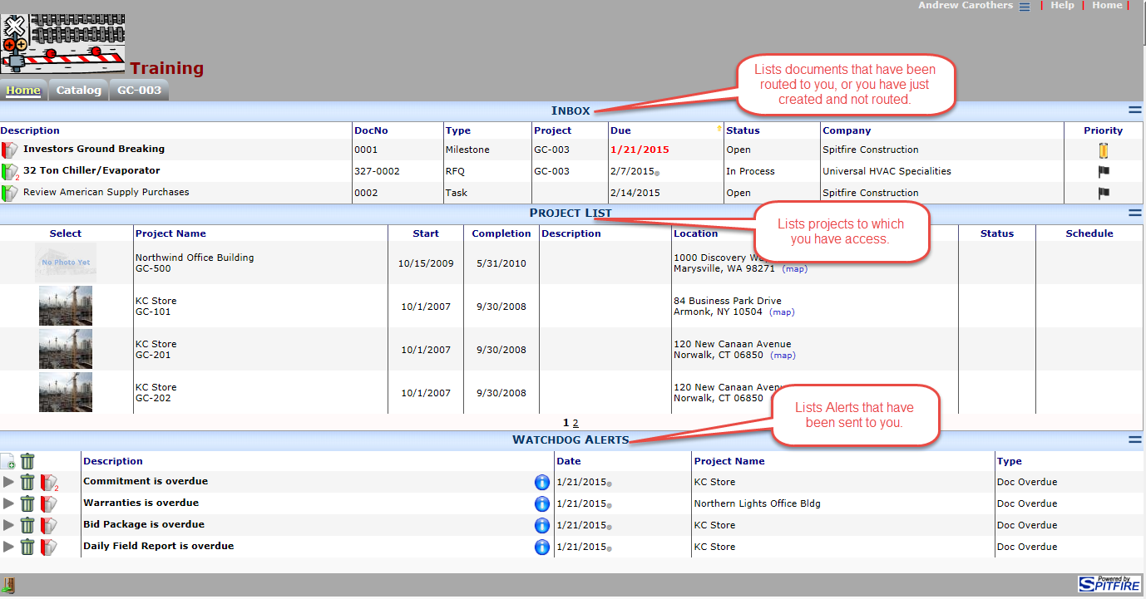
The Home Dashboard

Slide 10
Alerts on the Home Dashboard

Slide 11
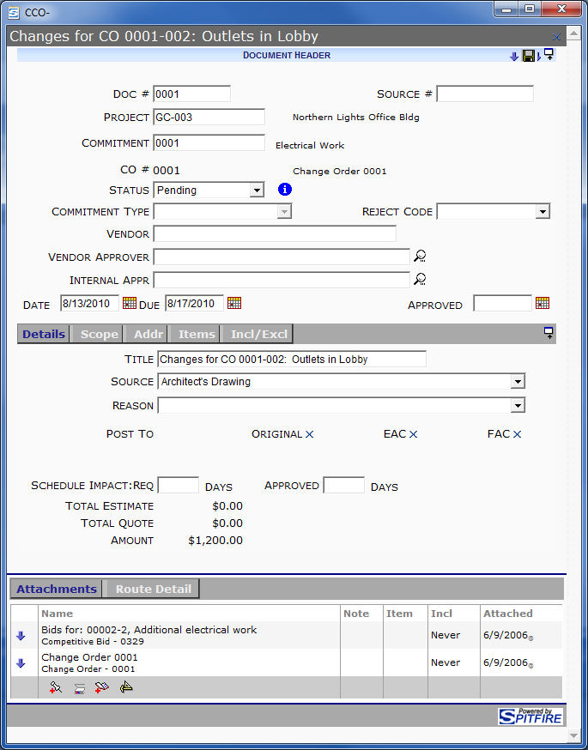
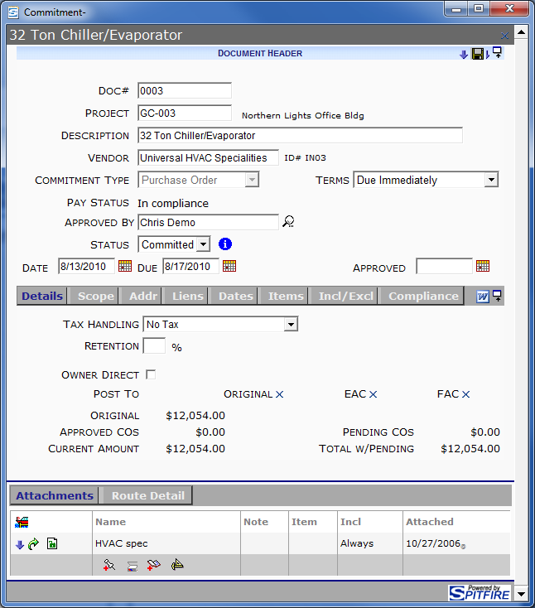
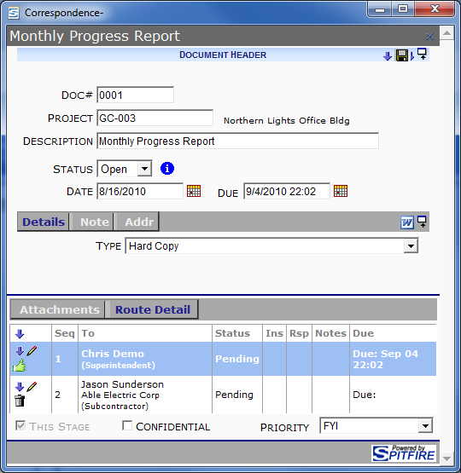
Concept: Documents vs. Files
Documents are created within Spitfire
Files are created outside of Spitfire
.PDF
.DOC / .DOCX
.XLS / .XLSX
.TIF
.JPG
.HTM
.MDI
.DWG
.DWF
etc.

Slide 12
You Can Access Documents
From the Project Dashboard
From your Inbox

Slide 13
The Inbox on the Home Dashboard

Slide 14
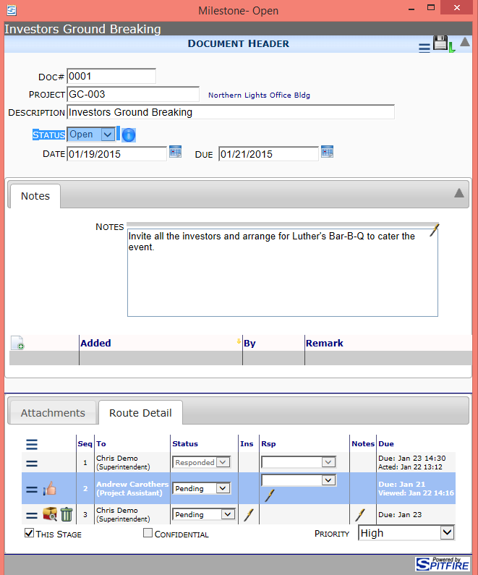
Parts of a Spitfire Document
Document Header
Where you identify the document and set the document status and due date
Mid-section Tabs
Where you input different types of data (varies by Doc type)
Attachments
Where you attach files and document
Route Detail
Where you indicate to whom the document is to be routed

Slide 15
“Thumbs Up” Your Route Row
To remove the document from your Inbox
To route the document to the next person, if any

Slide 16
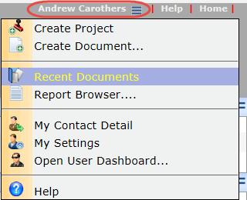
Open Recent Documents

Slide 17
Project List on the Home Dashboard

Slide 18
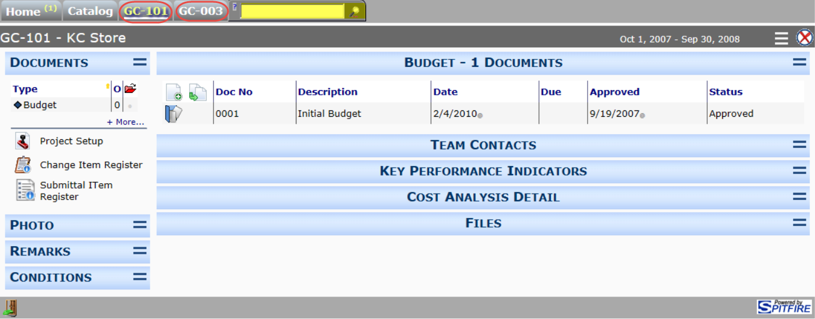
The Project Dashboard
You can open more than one Project Dashboard at a time
Use the + Tab to open a Project Dashboard from any other dashboard

Slide 19
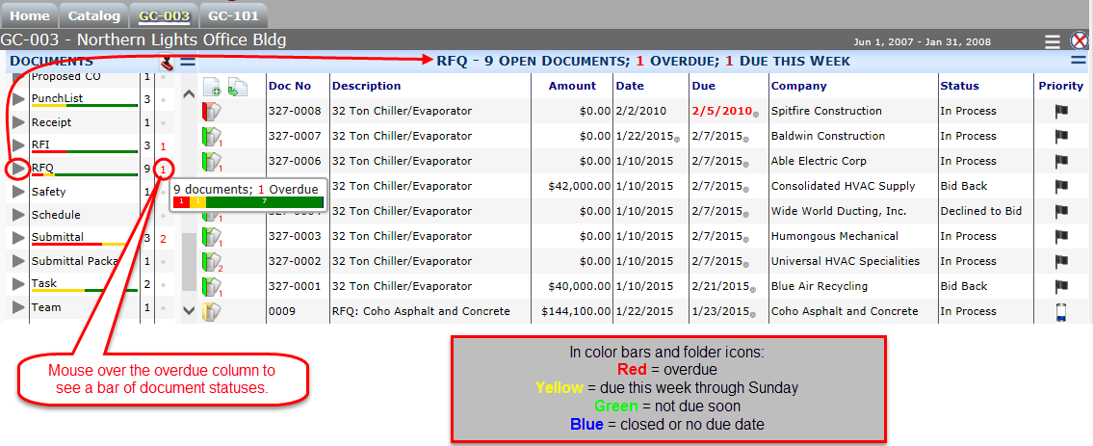
The Document Menu and List

Slide 20
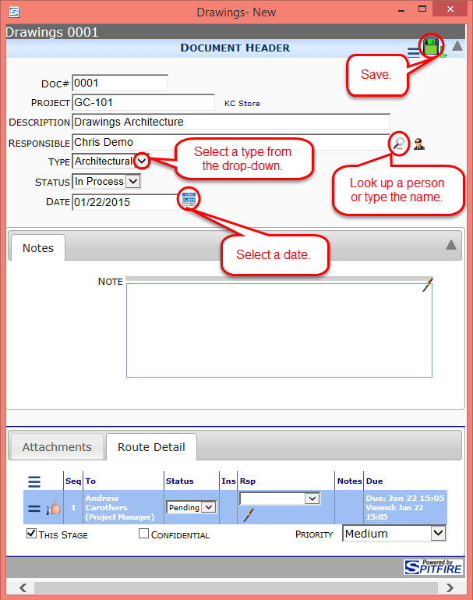
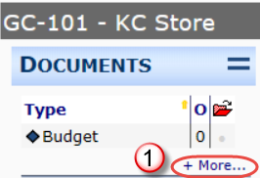
Create a New Document

Slide 21
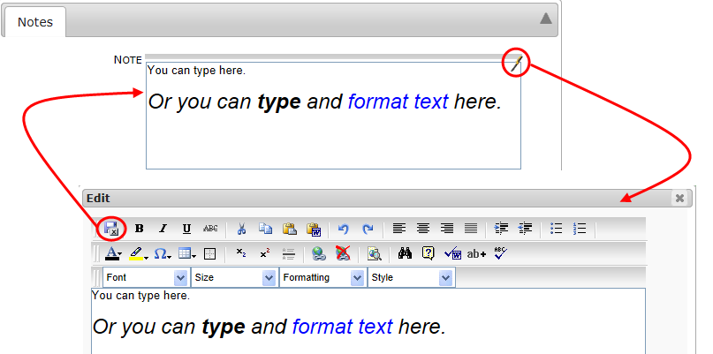
Enter Notes

Slide 22
Reopen the Document
Also from your Inbox

Slide 23
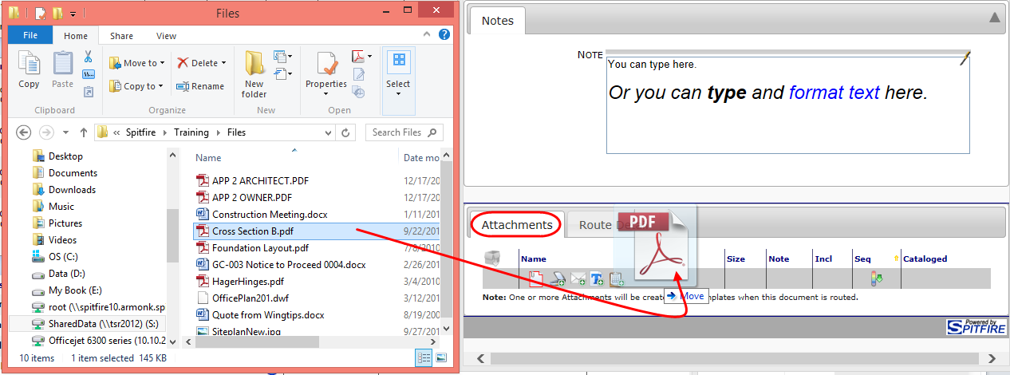
Attach Files to the Document
Drag and Drop

Slide 24
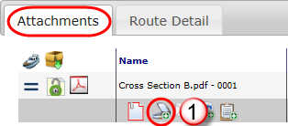
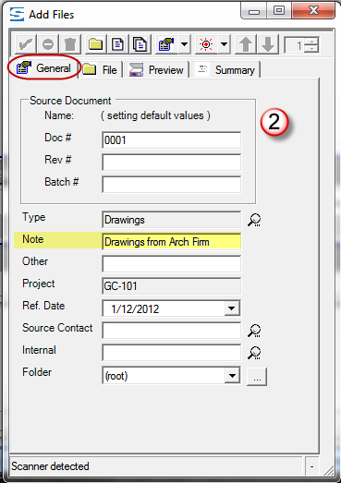
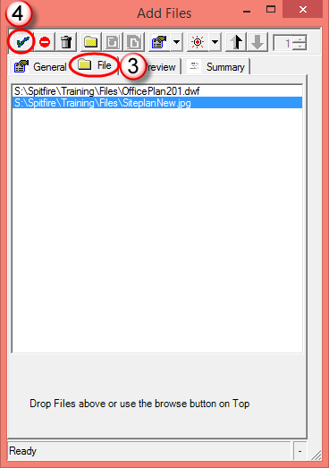
Attach Files to the Document
Use the Add Files tool

Slide 25
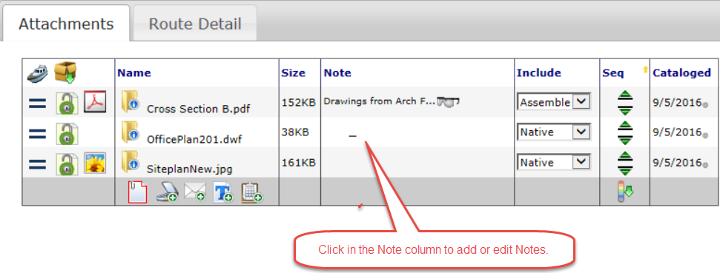
Add Notes in Attachments Tab

Slide 26
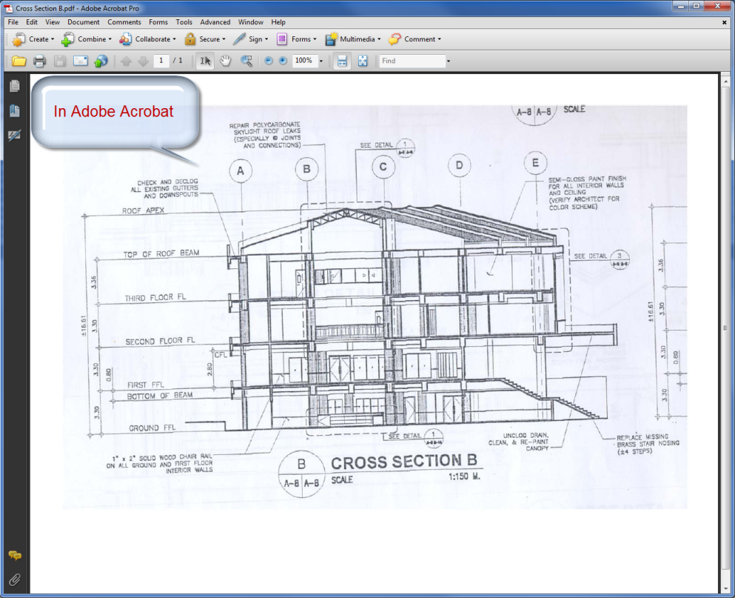
View/Edit an Attached File

Slide 27
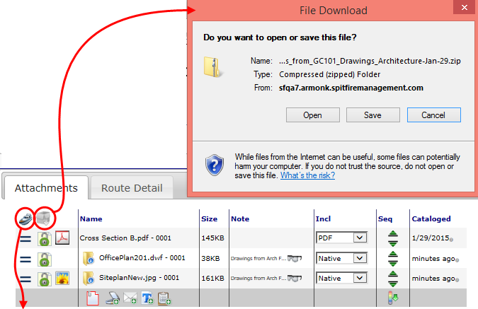
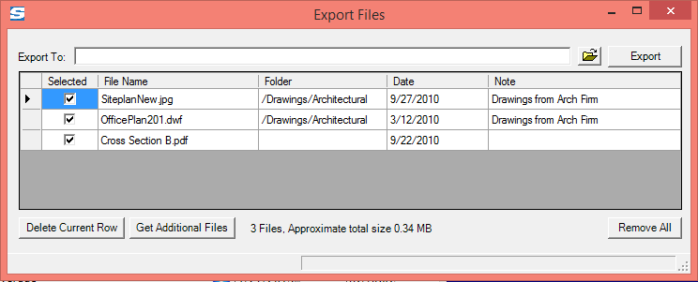
Export /Download the Attached Files

Slide 28
Route Detail Tab
When you create a document, you are Seq #1
You can route the document, if desired, but not all documents need to be routed.

Slide 29
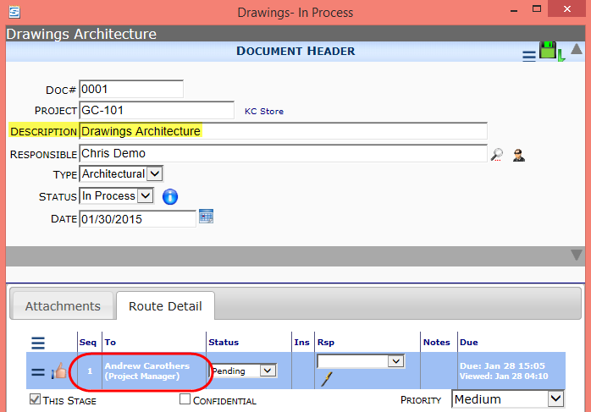
Route Sequences
Documents go from Seq # to Seq #
If it’s at your Seq #, it is in your Inbox

Slide 30
Remember to “Thumbs Up”
To remove the document from your Inbox
To route the document to the next person, if any

Slide 31
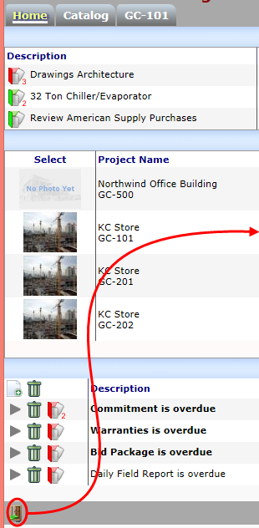
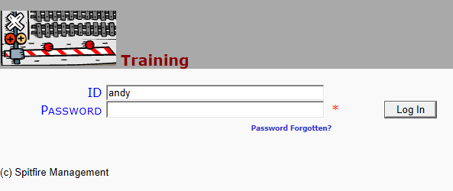
Log Out As Needed

Slide 32
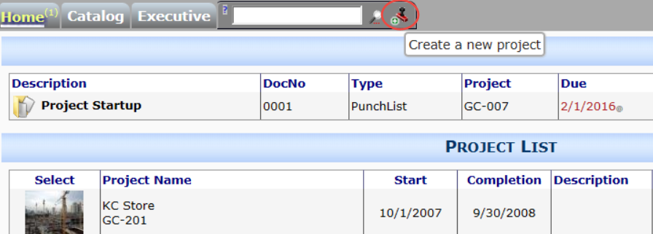
New Projects
Create a new project from the + tab

Slide 33
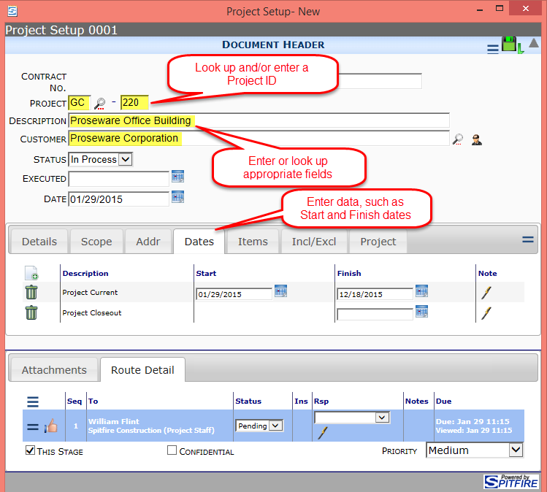
Project Setup (Contract)

Slide 34
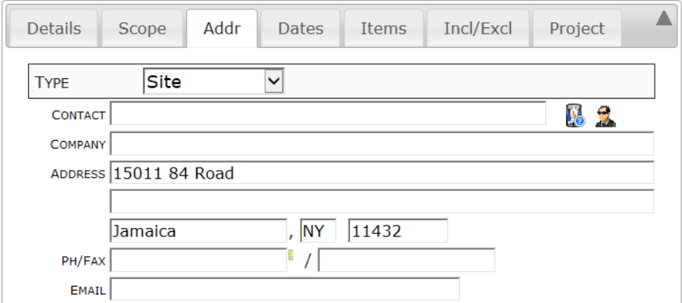
Site Address
The ZIP code of the Site address is used for weather conditions, so you’ll want to enter a Site address for your project.

Slide 35
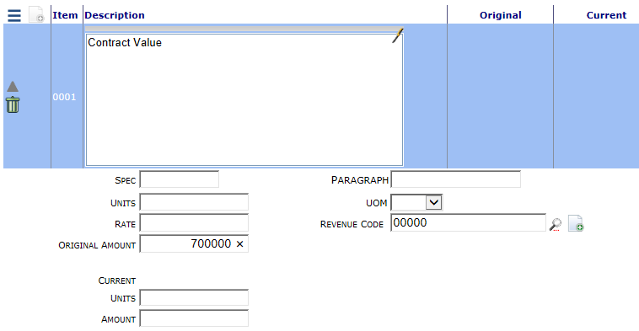
Add an Item

Slide 36
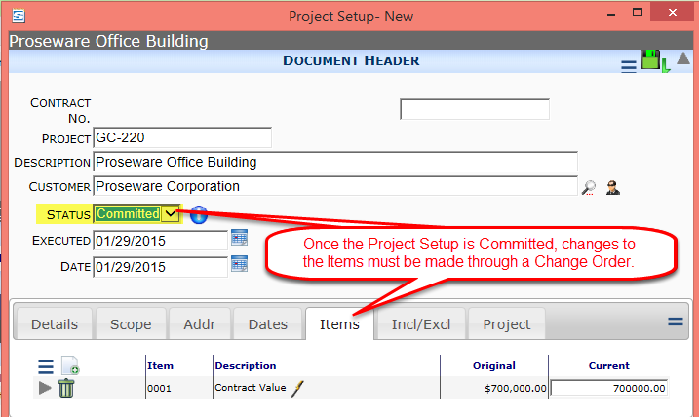
“Committed” Project Setup

Slide 37
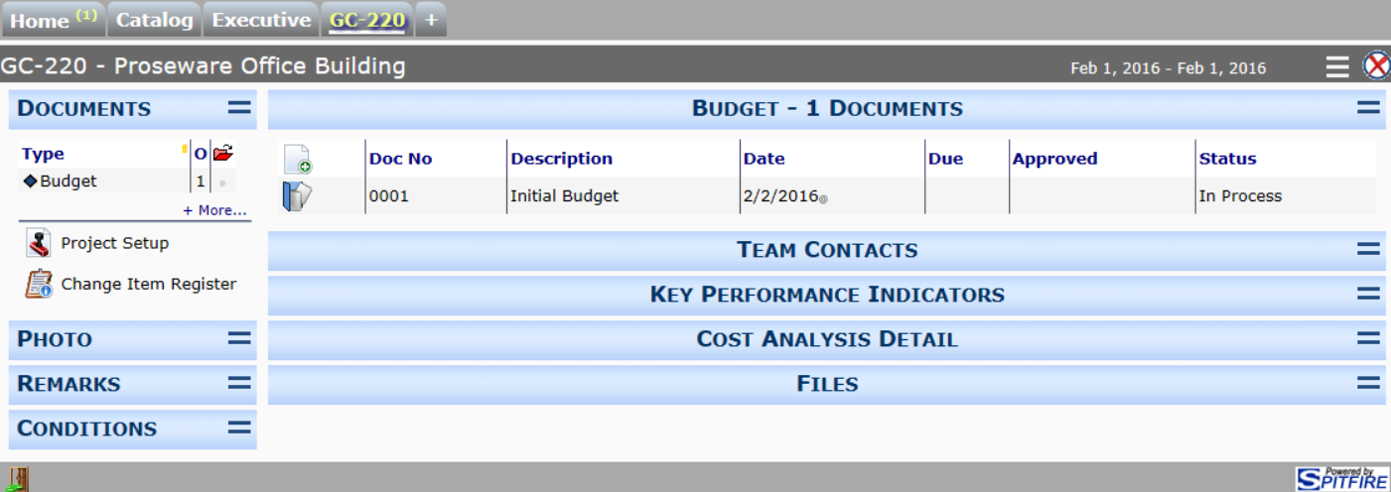
Your New Project Dashboard
The Project Dashboard is created when you first save a Project Setup document

Slide 38
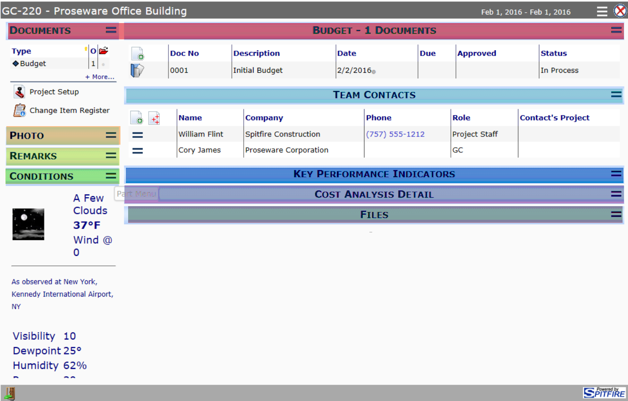
Parts of the Project Dashboard

Slide 39
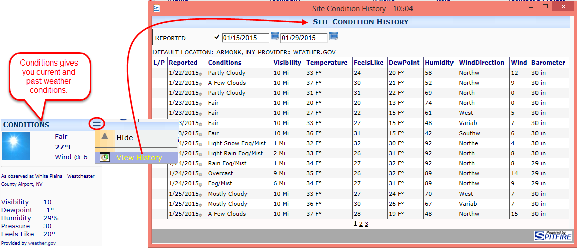
Weather Conditions

Slide 40
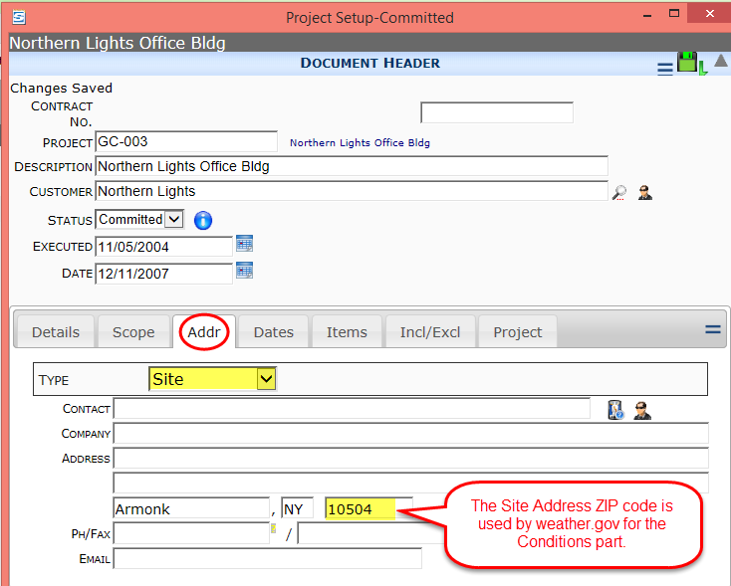
Where Does Weather Come From?
From the Project Setup document

Slide 41
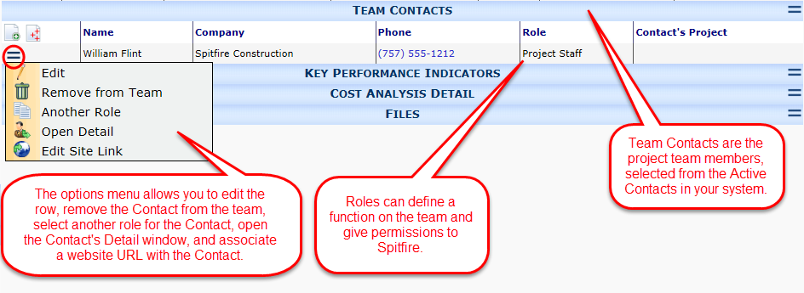
Contacts on the Project Dashboard

Slide 42
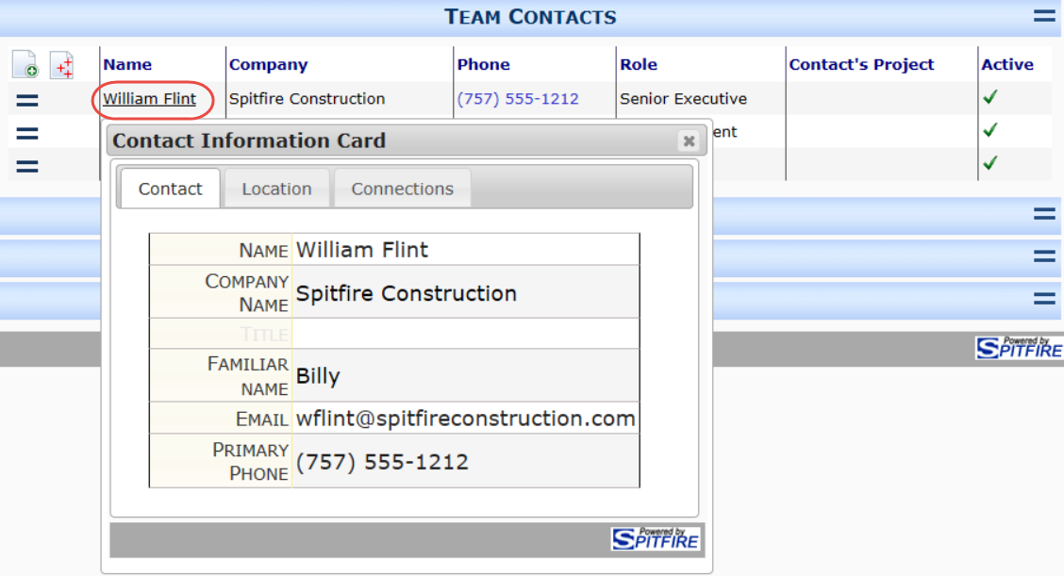
Contact Card
Click a name to see a summary of Contact info.

Slide 43
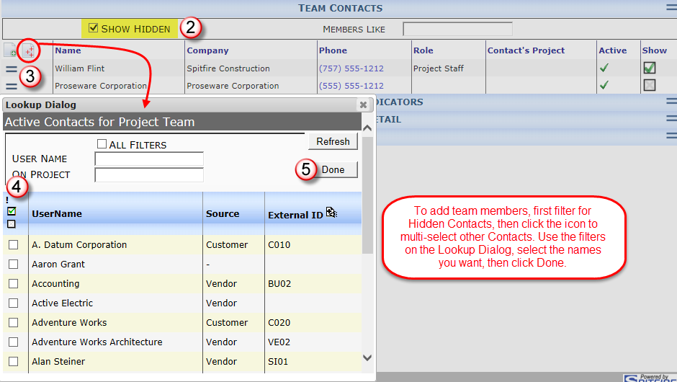
Add Project Team Contacts

Slide 44
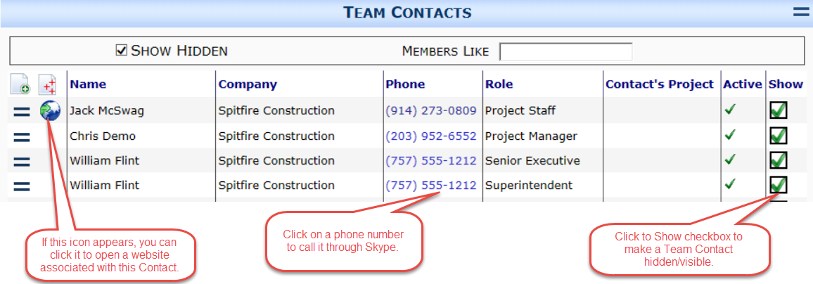
Team Contacts

Slide 45
Select a Role for a Team Member

Slide 46
Select a Second Role

Slide 47
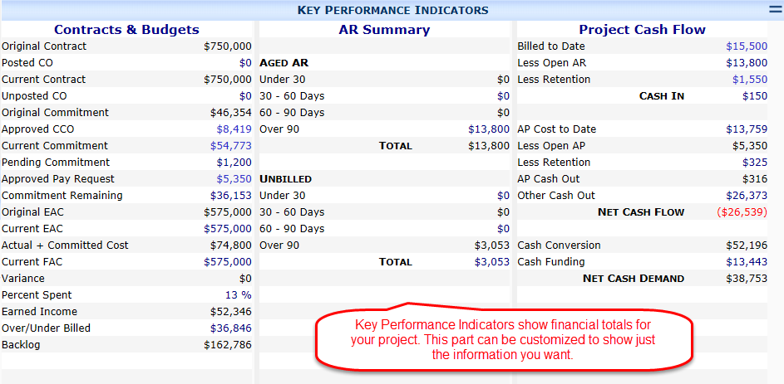
KPI on the Project Dashboard

Slide 48
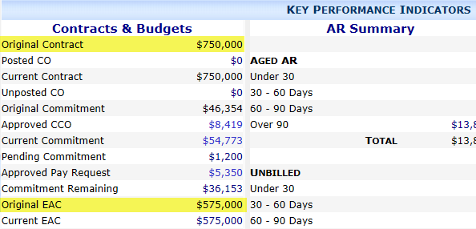
KPI
Original Contract comes from the Project Setup
Original EAC comes from the BFA workbook (budget)

Slide 49
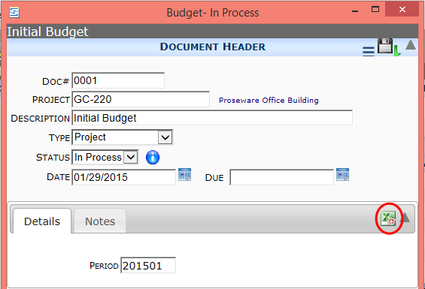
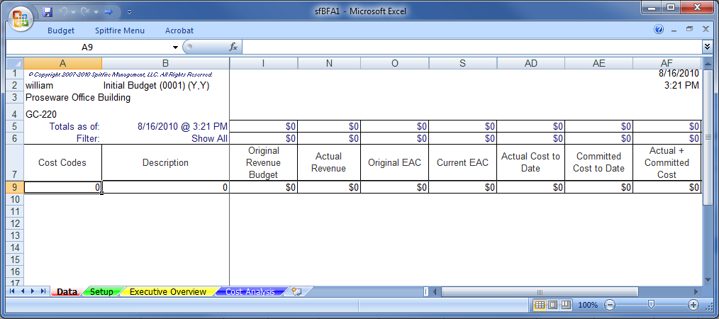
The BFA Workbook
Is accessed from the Budget document

Slide 50
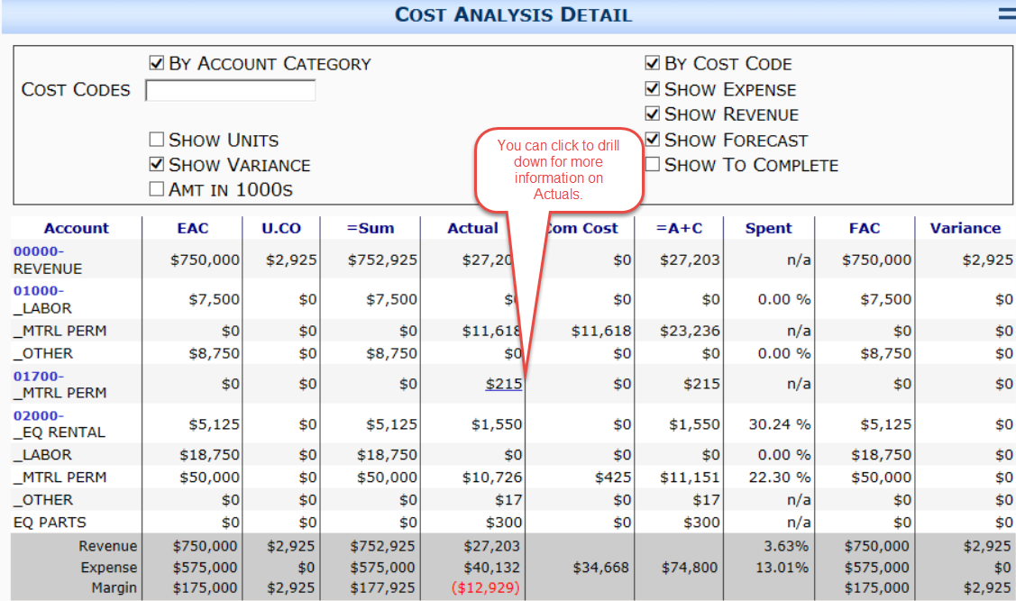
Cost Analysis Detail

Slide 51
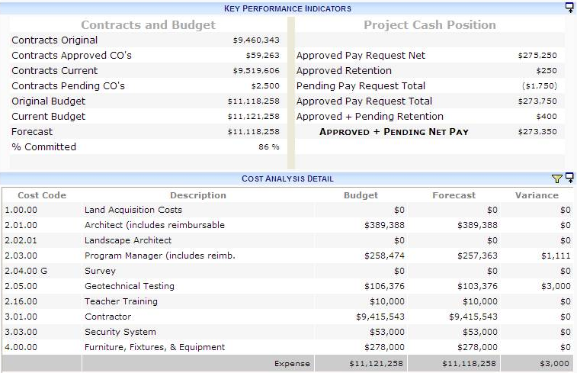
Another Look at KPI and CAD

Slide 52
Files on the Project Dashboard

Slide 53
Photo on the Project Dashboard

Slide 54
Remarks on the Project Dashboard

